Slide 1

A Farmboy’s Guide to
(Dinging) the Galaxy
Notes:
1
1

Slide 2

Types of objects in the world
Banana

Slide 3
Types of objects in the world
(with a particular focus on a particular object)
Banana
!
Non-banana

Slide 4
Types of models
(Yes, there’s a bit of bias in focus here!)
Linear
!
Nonlinear

Slide 5
Types of life events
(With a particular focus)
Key turning point
!
Rest of life

Slide 6
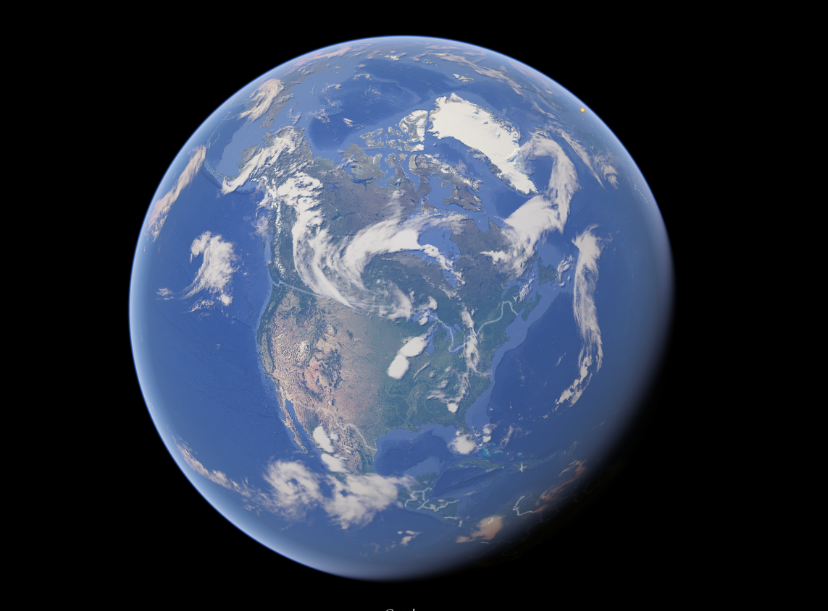

Slide 7
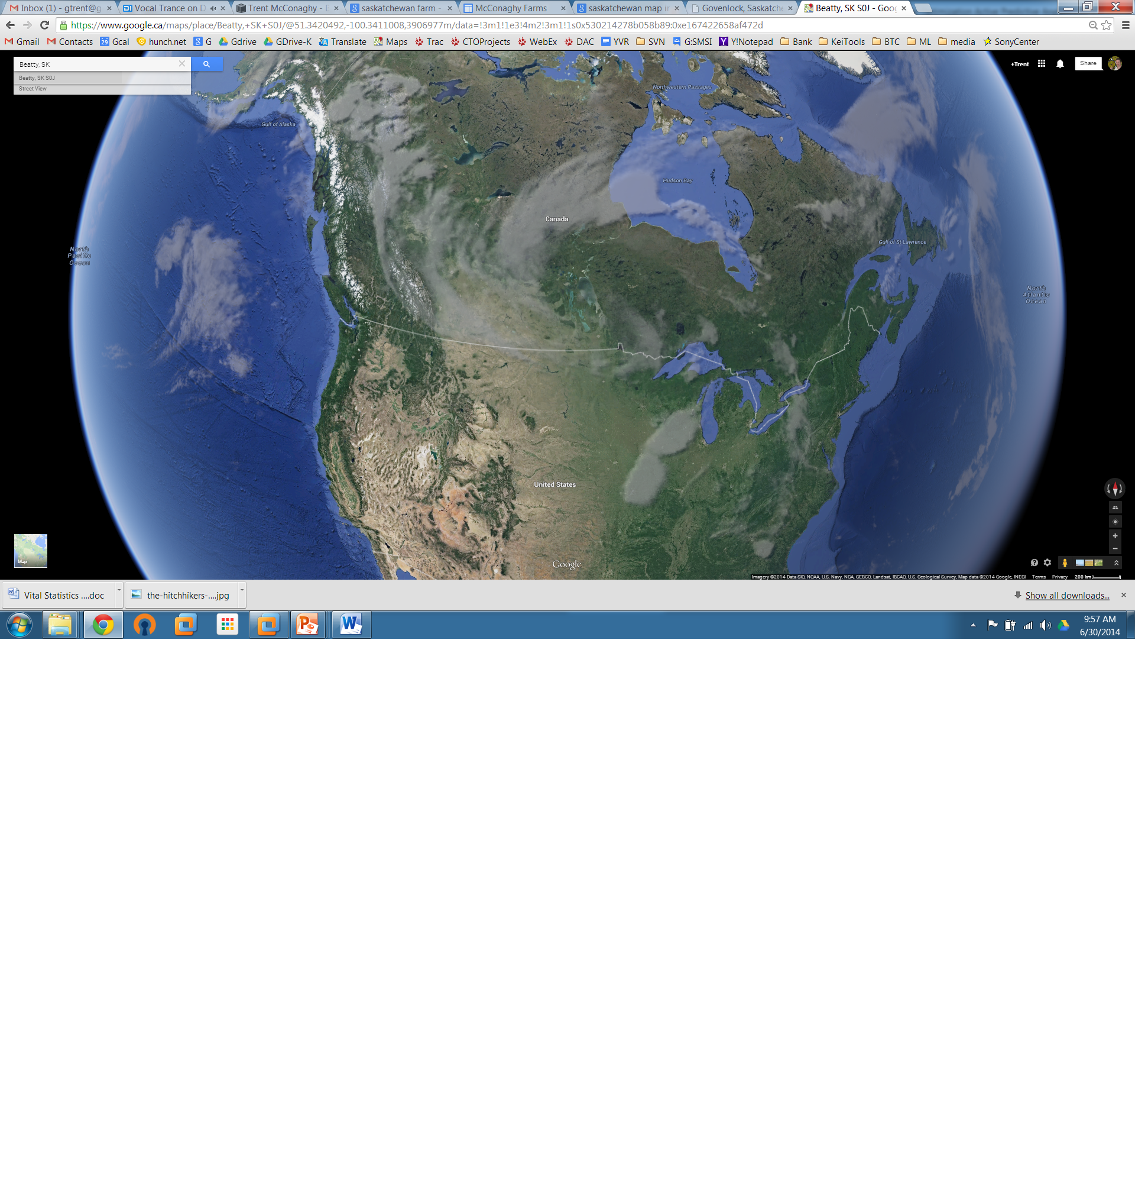
Canada

Slide 8
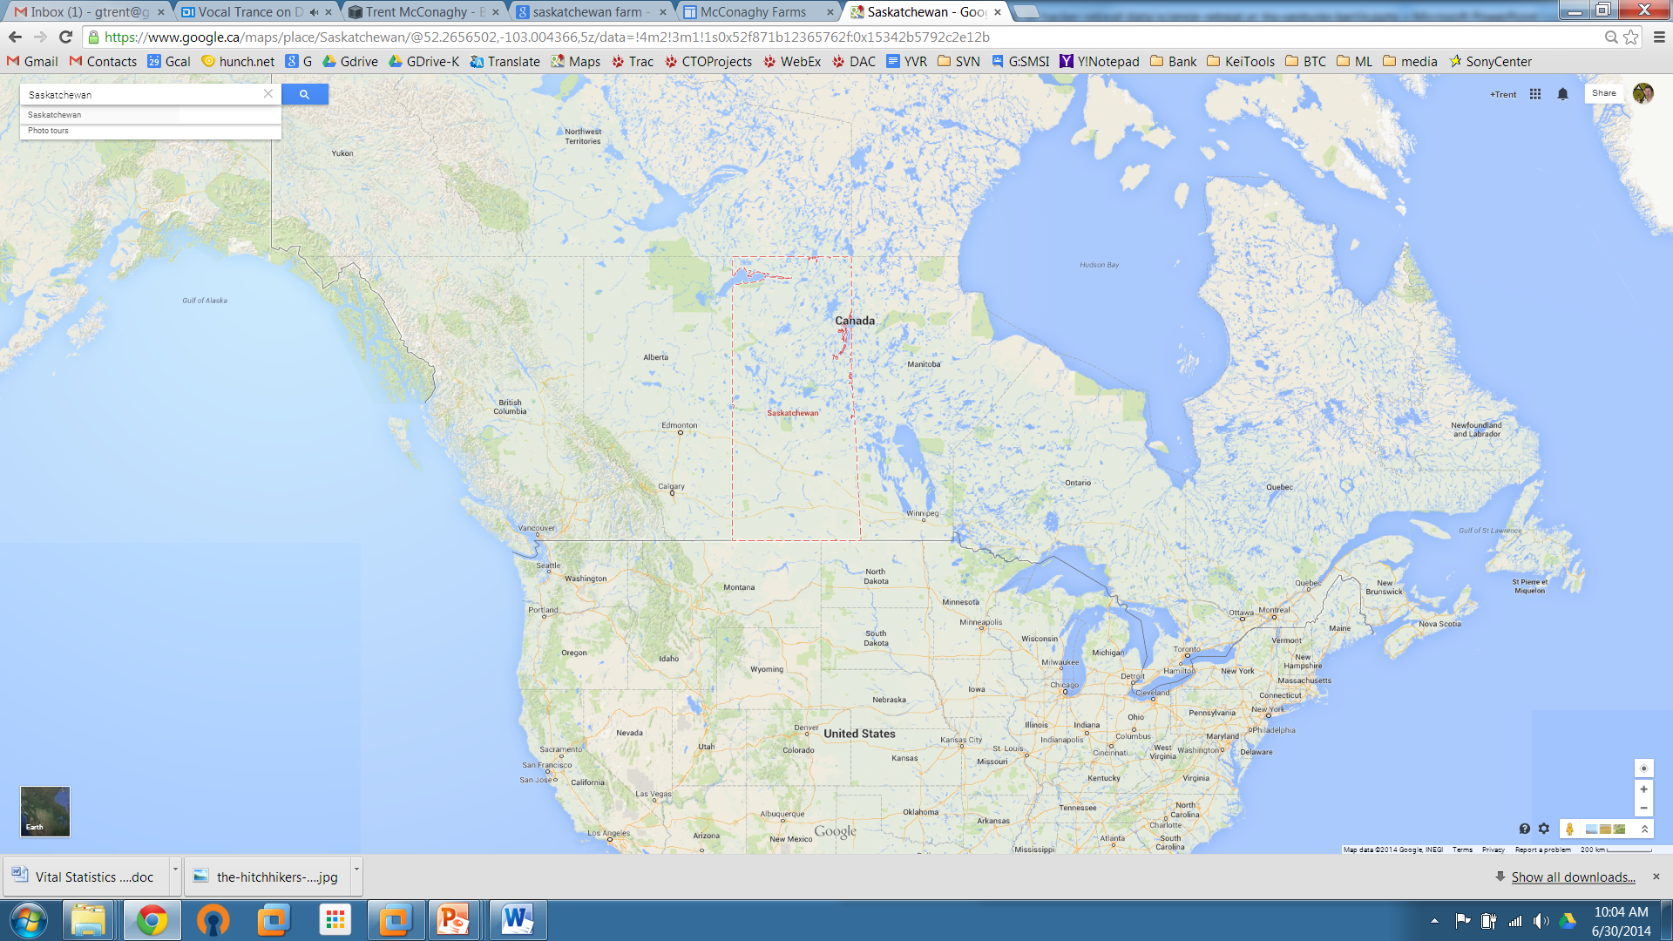
Saskatchewan,
Canada
McConaghy
farm

Slide 9
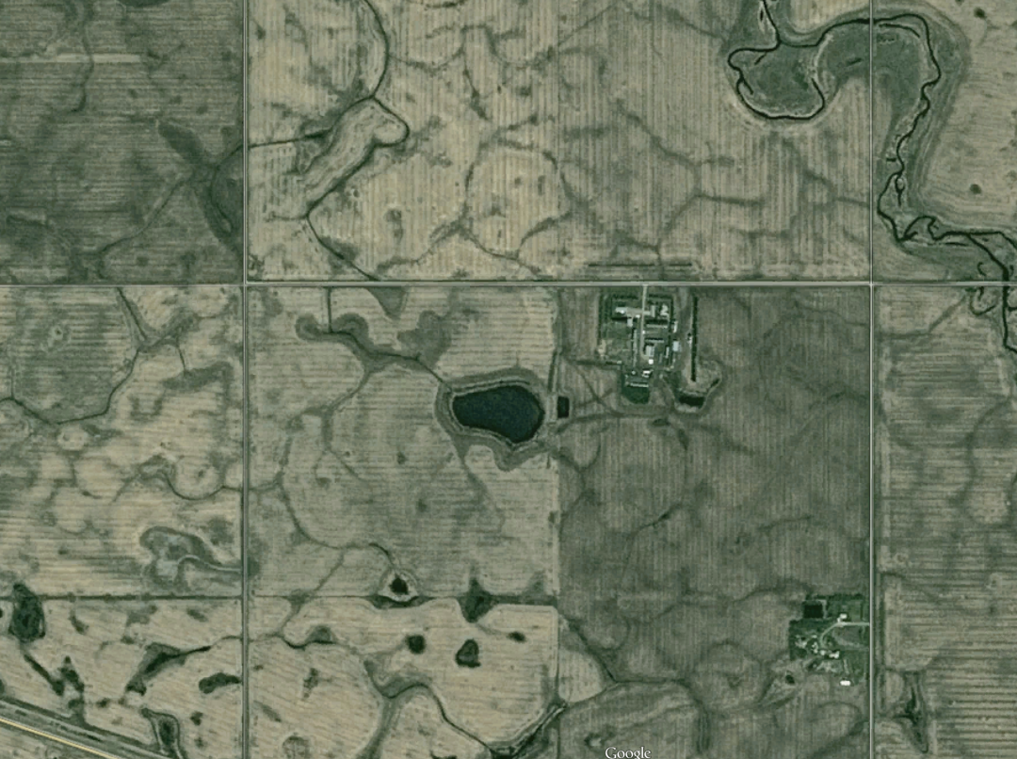
McConaghy
farm
(summer)

Slide 10
McConaghy
farm
(winter)

Slide 11
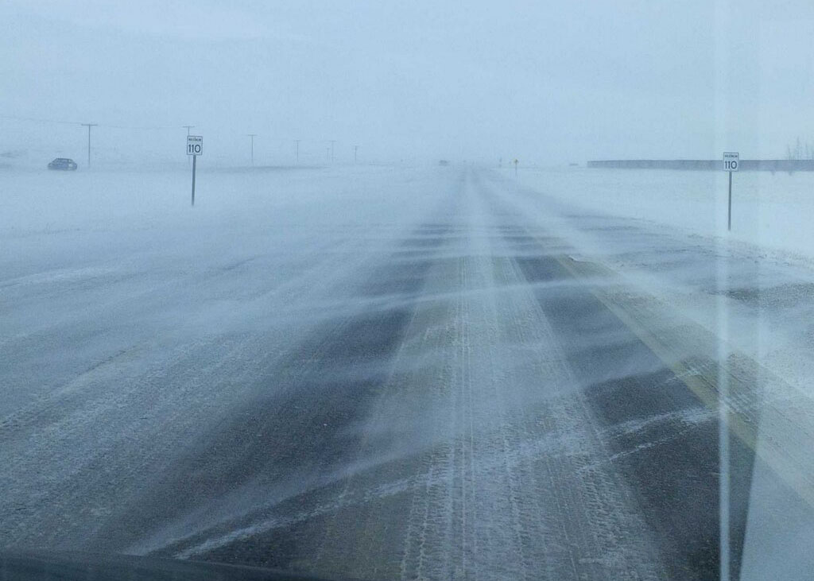

Slide 12
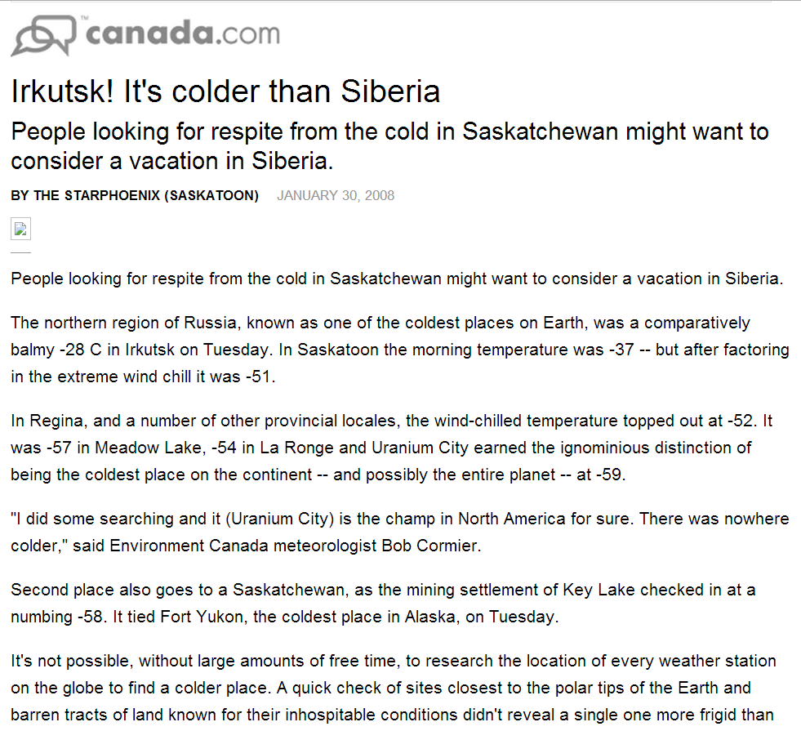

Slide 13
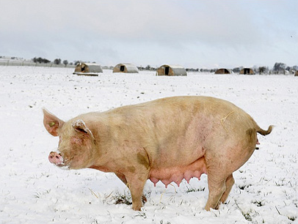
Pigs @ McConaghy farm

Slide 14
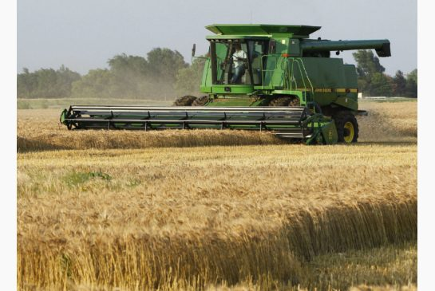
Grain @ McConaghy farm

Slide 15
Career Planning as a 12 Year Old (1989)
Passions:
“I love programming”
“I love to build stuff”
“Artificial Intelligence is cool (and it feels like it could change everything)”
Constraints?
“You and your two brothers will be taking over the farm”
Working plan:
“I’ll study Agricultural Engineering at the local university, then come back and farm”
(Notice a discrepancy here?)
Notes:
15

Slide 16
Career Planning as a 15 Year Old (1992)
Passions:
“I love programming”
“I love to build stuff”
“Artificial Intelligence is cool”
Constraints?
“You and your two brothers will be taking over the farm”
“Dad, there’s a chance I won’t farm.” **
Working plan:
“I’ll study Agricultural Engineering, then farm”
“I’ll study Engineering, but maybe it won’t be Agricultural”
** This was super hard to tell my father.
Notes:
16

Slide 17
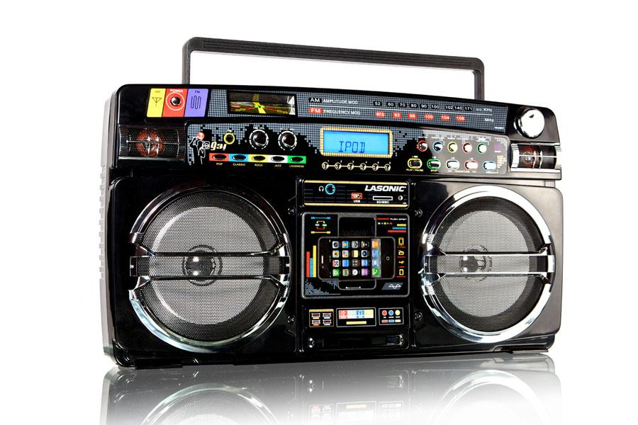
Career Planning as an 18 Year Old (1995)
Passions:
“I love programming”, “I love to build stuff”, “AI is cool”
Status:
Firmly established that I won’t be farming (yay!)
Just finished first year engineering
Also doing CS. Two degrees in 5 years = efficient!
Question: “Engineering physics vs. electrical?”
Designing <unclear> vs. <ghetto blasters and DVD players> **
Final choice: electrical, for opportunities in student politics! (I do like to talk :)
** Note the severe lack of information!
Notes:
17

Slide 18
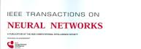
Career Planning as an 18.5 Year Old (2nd year EE) (1995)
Passions:
“I love programming”, “I love to build stuff”, “AI is cool”
Question: “How exactly do I get into AI?”
No idea!
But I did discover that I could subscribe to IEEE Transactions on Neural Networks. (Yay! Bedtime reading)
I also discovered the periodicals in the engineering library. (Yay! 1994 Genetic Programming workshop!)
Also for fun, I learned C/C++, played with NNs
Notes:
18

Slide 19
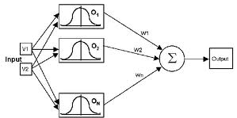
Career Planning as a 19 Year Old (3rd year EE) (1996-97)
Passions:
“I love programming”, “I love to build stuff”, “AI is cool”
“How exactly do I get into AI?”
Summer job opportunity: National Defense doing AI
Whoa! Best job ever! I applied.
How I got the job: “experience with C++ and NNs” (!!)
My job: using radial basis function NNs to classify audio tank signals. Yay!
Notes:
19

Slide 20
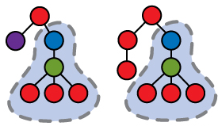
Career Planning as a 20 Year Old (4th year EE) (1997-98)
Passions:
“I love programming”, “I love to build stuff”, “AI is cool”
New data points:
Class on analog circuits. Manual, creative, math. Yay!
Saw just-published IEEE Trans. on Evolutionary Computation 1(1). Had paper on auto design of analog circuits! (using Genetic Programming - GP)
  First thought: agh, I’ll be obsolete!
  Second thought: perhaps I can do AI-based design?
My next summer job: back at National Defense. But this time: I did GP, went to a GP conference, met GP people!
Notes:
20

Slide 21
Career Planning as a 21 Year Old (5th year EE) (1998)
Passions:
“I love programming”, “I love to build stuff”, “AI is cool”, “Startups are cool” (this was 1998)
“What to do after grad?”
PhD on AI, vs start a company, vs get a job
“What to do for final-year team design project?”
Chose (with five colleagues):
Start a company using design project
As backup, line up funding for PhD
Notes:
21

Slide 22
How I spent my final year of undergrad (1998-99)
Chose a project:
  Brainstormed 50 ideas, filtered on potential etc.
  Ended up with (perhaps unsurprisingly) AI for circuits
  Prof: “No chance. I’ll buy you steak dinners if you can do this.” Another: “If it could be done it would have been done already”. The gauntlet was thrown..
Bought time: no class, just textbooks. Project 40-60 h/wk
Built it! 10x state-of-the art! Free steaks!
  We presented our design project as a company, calling it “Analog Design Automation Inc.”
Got full PhD funding too. (For AI research of course☺)
And then the project became the company, for real…
Notes:
22

Slide 23
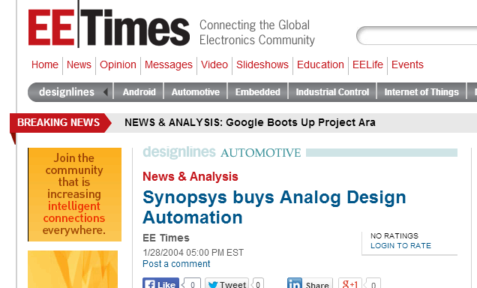
Analog Design Automation Inc. (1999-2004)
Corporate history:
Incorporated the day after last final exam
1999 - $50K gov’t grant
1999 - $500K seed
2000 - $8M series A from Intel & other VCs
2002 - $2.5M series B
Grew from 6 to 30 people. (“Valuation α headcount”)
Early 2004 – sold company
Notes:
23

Slide 24
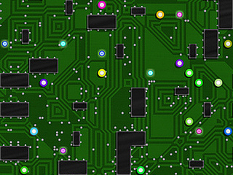
Analog Design Automation Inc. (1999-2004)
Tech history:
Initial “product” optimized topology + parameters
Discovery: Designers hesitate to adopt it because of trust.
Discovery: as a 1st cut, customers only needed to optimize parameters. Sol’n: just optimize in Euclidian space (easier)
Discovery: scalability matters more than optimality. Solution: global → local opt. (easier yet!). Became an edge.
Discovery: the right visualization really matters. Built an adjacent product. It became an edge.
Personal realization: Moore’s Law really matters to humanity. Backbone of other tech, and econ. growth
Notes:
24

Slide 25
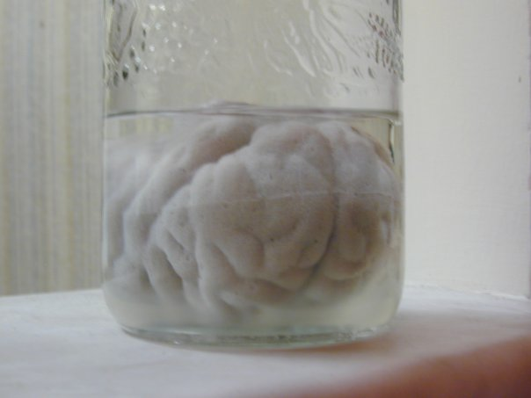
Life & Career Thoughts as a 27 Year Old (2003)
“My feet are itchy. I’m a bit bored at what I’m doing.”
“I’d love to travel the globe”
“I’d love to live in Europe”
“I’d love to live on a beach and surf all the time”
“I’d love to write a novel”
“I’m a researcher at heart. A PhD would be cool.”
“I’d love to make analog synthesis trustworthy.”
“Neuro is cool (feels like it could change everything)”
While still..
“I love programming”
“I love to build stuff”
“AI is cool (feels like it could change everything)”
“Startups are cool (esp. as a means to an end: neuro..)”
Notes:
25

Slide 26
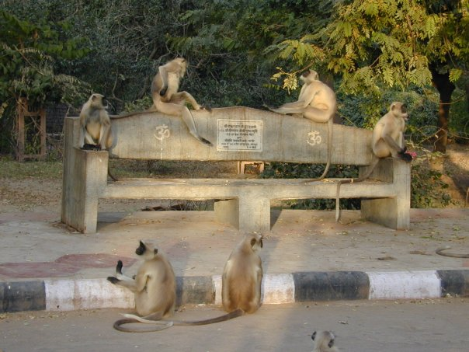
Life & Career Planning as a 27 Year Old (2003)
I designed the following plan
It resolved all my goals!!
Starting in 2004, leave of absence from ADA
Backpack Southeast Asia for a month
Live in on the beach in San Diego for six months
  Surf!
  And write a novel
Then start a PhD in Belgium (I “knew a guy”)
  Make analog synthesis trustworthy
(Neuro can wait, startups can wait)
Notes:
26

Slide 27
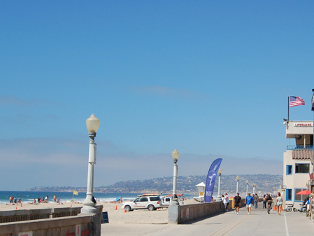
How My 2004 Plan Went Down (2004-)
[YEP] Starting in 2004, leave of absence from ADA
[YEP] Backpack Southeast Asia for a month
[YEP] Live in on the beach in San Diego for six months
  [YEP] Surf!
  [Well..] Write a novel
    How an AI-style singularity can include humans. A business plan too..
    50 pages in, I paused. Too much info? Fiction?
    Instead I started a new company (oops ☺ )
[YEP] Then start a PhD in Belgium (I “knew a guy”)
  [YEP] Make analog synthesis trustworthy
Notes:
27

Slide 28
2004-2008: PhD (1/3): MOJITO Flow
Core idea: Embed existing knowledge in a library of trusted circuit blocks.
Equivalently: the library is a grammar. Therefore a circuit is a sentence in the grammar.
Challenges:
design the grammar. Solve via tearing hair out.
populate it. Solve via mining textbooks and papers.
search it. Solve via Genetic Programming++
Objectives,
Constraints
Block library = Giant Set of Circuit Topologies
Synthesis
simulator
simulator
simulator
Sized topologies

Slide 29
2004-2008: PhD (2/3): 35 Blocks → 100K+ topologies!
ds amp vdd/gnd ports
ds amp1 vdd/gnd ports
ss amp1 vdd/gnd ports
OR
OR
OR
ds amp1 vdd/gnd ports
ds amp2 vdd/gnd ports
ds amp1
ds amp1
ss amp1
ss amp1
AND
ds amp1 vdd/gnd ports
ss amp1 vdd/gnd ports
capacitor
ds amp1
AND
ds load
dd input
AND
OR
current mirror
wire
dd stacked input cascode
dd folded input cascode
OR
AND
AND
simple CM
cascode CM
low power CM
biased mos3
ss input
biased mos3
ss input
ss amp1
AND
AND
AND
AND
mos3
x 2
mos3
x 4
mos3
x 4
ss input
ss load
OR
OR
resistor
cascoded ss load
biased mos3
AND
ss stacked input cascode
ss folded input cascode
cascode device
biased mos3
AND
AND
cascode device or wire
mos3
source degen
cascode device
biased mos3
mos3
source degen
mos3
OR
cascode device
wire
source degen
cascode device
biased mos3
mos4
OR
AND
OR
wire
resistor
biased mos3
biased mos3
dc voltage source
mos3
nmos4
pmos4

Slide 30
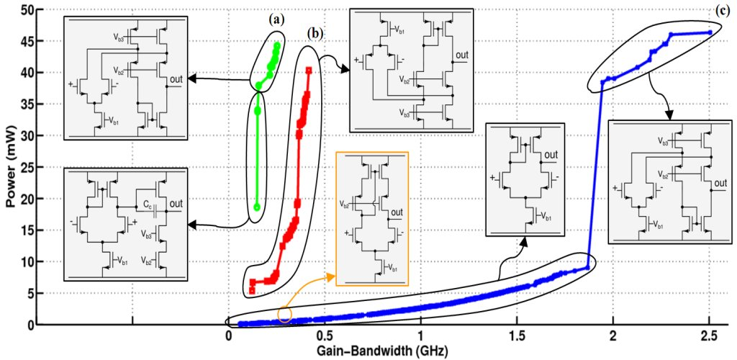
2004-2008 PhD (3/3) Some results: it automatically synthesized these structures & parameters.

Slide 31
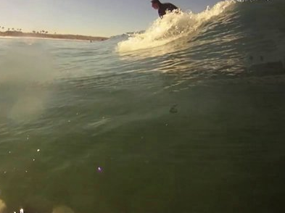
Solido Design Automation Inc. (2004-now)
Corporate history:
2004 – research on the beach (surf in am, invent in pm)
  I realized: in time, variation could kill Moore’s law.
  I could be waiting with software to save the day☺
  I built an AI-based prototype to demonstrate. (Efficiency+ compared to undergrad!)
  My biz partner found lead customers. Then investors.
2005 - $2M series A
2006 - $7.5M series B
Profitable. Half of top 20 semis as customers (Sony, Nvidia, Qualcomm, Huawei, ..)
Notes:
31

Slide 32
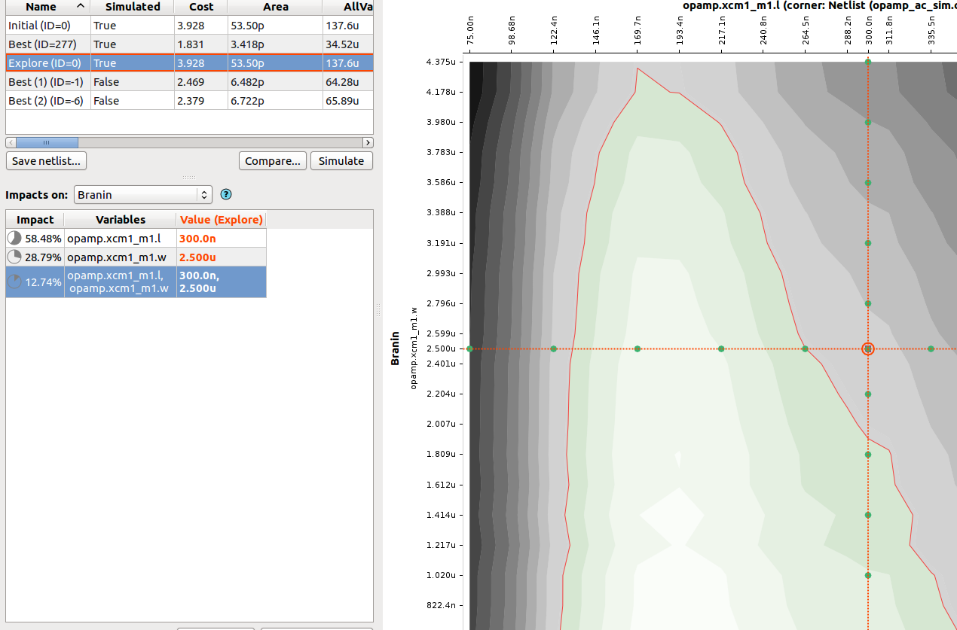
Solido Design Automation Inc. (2004-now)
Tech history:
Started with one product
Once success with first product, expanded by a new product every year or so
Always improving speed + scalability of existing products
AI at the core of it all (our biggest differentiator)
Notes:
32

Slide 33
Solido Product Overview
Solido Variation Designer
Fast PVT
2-50X faster
verification across
PVT corners
Fast MC
2-10x faster 3σ verification, statistical corners
High-Sigma MC
Fast, accurate,
scalable, verifiable
6σ Monte Carlo
Hier. MC
Fast statistical memory array / column analysis
Cell Optimizer
Auto variation-aware design space exploration of memory/std cells
Fast Design Sweep
Fast, thorough manual variation-aware
design space exploration
PDK Interface
Parallel Simulation Interface
Environment Interface
TSMC
Synopsys HSPICE®/ CustomSim™
Cadence Spectre®/APS
Cadence Virtuoso® ADE
GLOBALFOUNDRIES
Synopsys FineSim™
Berkeley Design Analog FastSPICE™
Netlist
Samsung
Agilent GoldenGate
Mentor Eldo®
Internal/Other

Slide 34
AI/ML In Solido Products
Density estimation
Low-discrepancy sampling
Evolutionary optimization
Data mining / var. sensitivity
Rare-event estimation
Adaptive ranking
High-dimensional regression
High-dimensional classification
Regression with CIs
Model-based Optimization
Solido Variation Designer
Fast PVT
2-50X faster
verification across
PVT corners
Fast MC
2-10x faster 3σ verification, statistical corners
High-Sigma MC
Fast, accurate,
scalable, verifiable
6σ Monte Carlo
Hier. MC
Fast statistical memory array / column analysis
Cell Optimizer
Auto variation-aware design space exploration of memory/std cells
Fast Design Sweep
Fast, thorough manual variation-aware
design space exploration
Regression w/CIs
Model-based Optimization
Active learning
High-dimensional visualization
Data mining for var. sensitivity
Data mining for variable-interaction sensitivity
Hierarchical MC sampling
Hierarchical ranking
High-dimensional regression
High-dimensional classification
PDK Interface
Parallel Simulation Interface
Environment Interface
TSMC
Synopsys HSPICE®/ CustomSim™
Cadence Spectre®/APS
Cadence Virtuoso® ADE
GLOBALFOUNDRIES
Synopsys FineSim™
Berkeley Design Analog FastSPICE™
Netlist
Samsung
Agilent GoldenGate
Mentor Eldo®
Internal/Other

Slide 35
Example: Solido Fast PVT
Cast PVT verification as a global optimization problem:
Search through space of “corners” - x
Minimize / maximize simulated output value f(x)
Then, solve the optimization problem reliably.
Optimal f(x)
=worst-case pwr
f(x)
Example:
pwr(temp)
x (Example: temp)

Slide 36
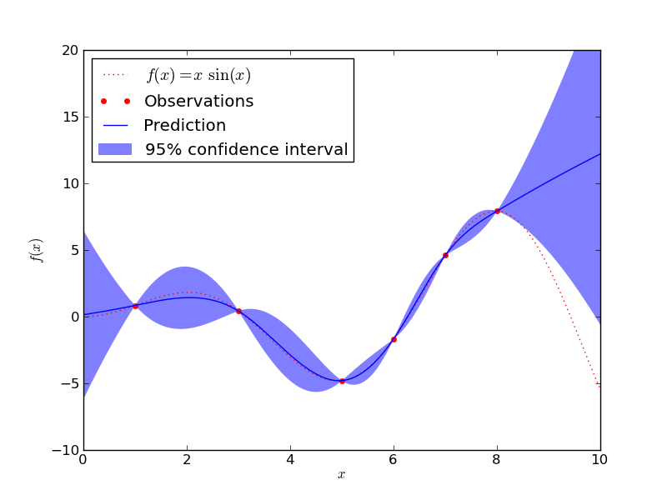
Fast PVT Underlying Model
Typically a Gaussian Process Model (GPM)
  Natural interpolator
  Convenient confidence intervals
  Well-behaved, no crazy extrapolation (usually)

Slide 37
Benchmarks on 226 Circuit PVT Verification Problems
226 test cases in benchmark suite:
  From Solido customers, in-house realistic cases, and in-house corner cases targeting challenging problems
  Many contain complex interactions, non-linearities, discontinuities, etc.
226/226 (100%) of cases find true optimum
Speedup 2.34X to 226X
Median speedup is 22X
Speedup

Slide 38
Fast PVT Scalability Challenge: # Samples
Problem: GPM training is O(N³) on # Training Samples
Becomes very unhappy when >1000 samples
This happens for circuit verification problems with larger # dimensions and highly nonlinear circuit
First solution: just cut loose and sim all
Is there a better way?

Slide 39
Fast PVT Solution: Divide-and-Conquer on Training Samples
x2
GPM 1
GPM 3
GPM 5
GPM 2
GPM 4
_{x1}
New model is a set of Gaussian Process Models (GPM)
One GPM for each region of input x space
Regions are automatically determined at build time
  Via classic CART learning
  Stop at a leaf when <700 samples
Build a GPM on each leaf’s samples (and k neighbors)
  Each GPM is O(1) on # training samples because N=const
  CART learning is O(N log N) on # samp with tiny constant

Slide 40
Benchmarking: GPM vs Divide-and-Conquer GPM

Slide 41
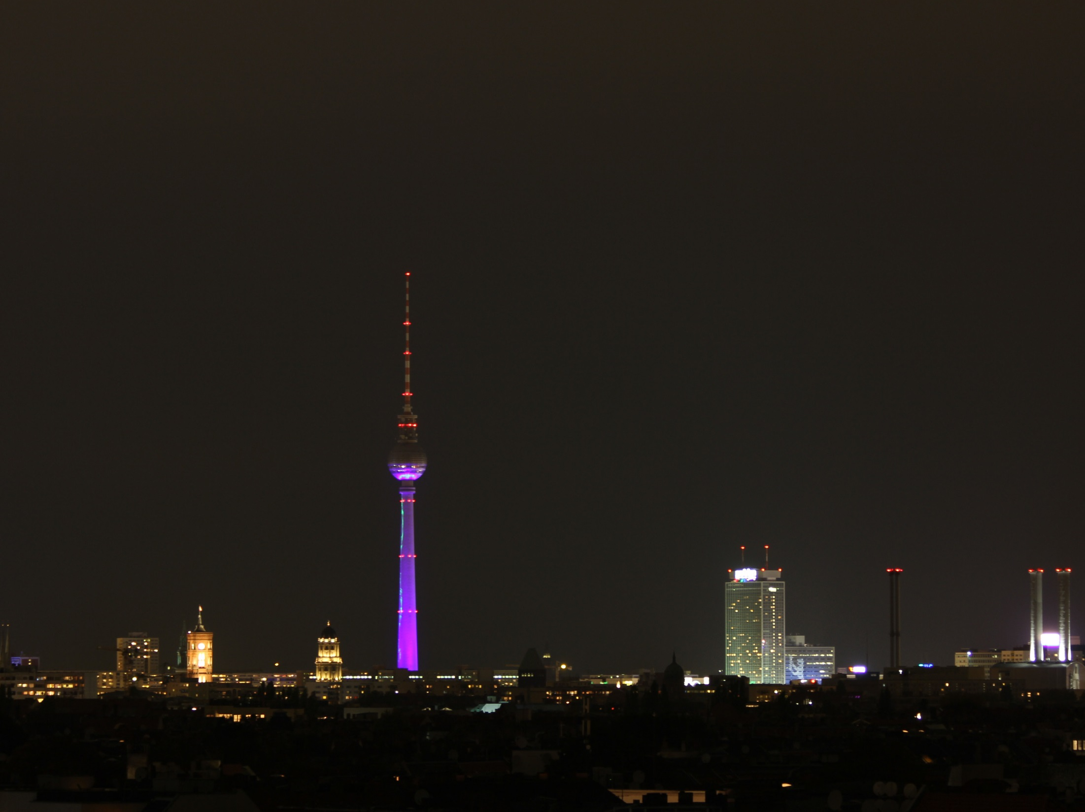
Life Planning as a 35 Year Old (2013)
“I kinda miss Europe (my wife does too)”
“Berlin is a cool city. Lotsa art happening”
So: “let’s try Berlin for a few months”
That was 18 months ago!
Notes:
41

Slide 42

Life&Career Planning as a 35.5 Year Old (2013)
“Bitcoin is cool. Blockchain in particular.”
“The art world has some specific challenges.”
So, what if…
  That’s my other venture now – Keidom
  And it’s not just art. It’s ownership.
(Not 100% on it: babies to feed, salary=good)
Notes:
42

Slide 43
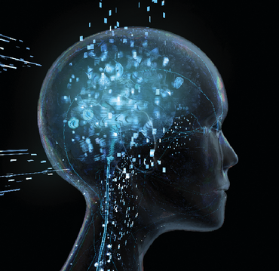
Life & Career Planning as a 37 Year Old (2014)
“Neuro is cool.”
Neuro/BCI is a way for an AI-type singularity to include humans
There’s a cost-effective way to approach this
It’s getting close to the right time…
How to ding the universe:
Choose high-impact problems
Approach at high leverage points
Keep swinging
Buy more time: don’t retire
Really buy more time: don’t die! (see singularity..)
Notes:
43

Slide 44

A Review
Looking back,
I realize I can identify my career’s turning points:
I’ve chosen those turning points in the last 10+ years.
(vs stumbled onto, or worse, had them decided for me)
Intentional career & life design.
Guided by my passions, what might be fun/cool, and the future I want for myself and humanity
Design process includes asking questions, writing down goals & constraints, evaluating possibilities
They took courage to implement. Status quo = easy.
AI has always been a passion. Perhaps fortunate since AI opens many doors☺

