Slide 1
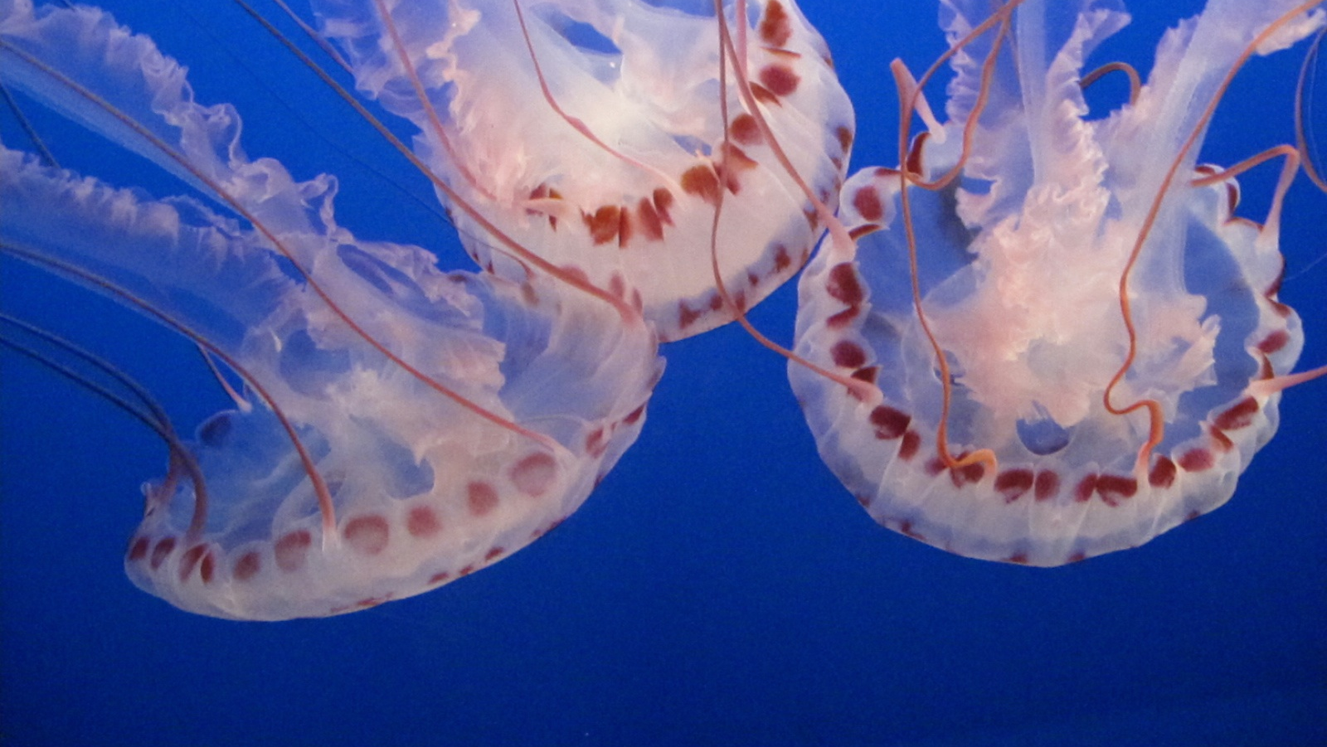
Ocean Protocol
New superpowers for data scientists
Trent McConaghy
@trentmc0

Slide 2
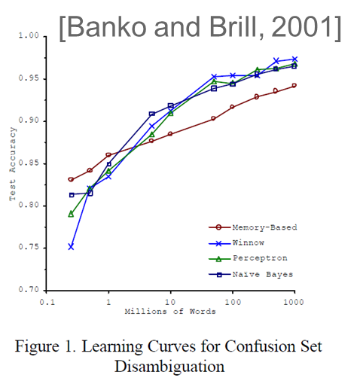
AI Loves Data
1000% less error!
1000x more data
Notes:
Despite successes here and there, up until recently AI was not widespread. For decades, AI researchers were churning out papers like crazy with all their new pet algorithms, on the same shared datasets; but there was often barely a dent in accuracy. You’d go from 25% to 24% error, still super far away from something usable which usually needs at least 1%.
But then a breakthrough occurred. Researchers started to realize that maybe, just maybe, more *data* could help.
This plot shows how with the same algorithm, if you increase the size of the dataset by 1000x, you can bring error from 25% to 3%. The choice of the algorithm hardly mattered in fact. What matters was the amount of data. Data was unreasonably effective.
Researchers at Google called this “the unreasonable effectiveness of data” and published a paper on it in 2007. Since then, their driving mission has been “get more data”.

Slide 3
Deep Learning Really Loves Data
DL models with >> capacity
Error 5% .. 0.01%
Models with limited capacity Error 25% .. 5%
Another 1000x more data
Notes:
Despite successes here and there, up until recently AI was not widespread. For decades, AI researchers were churning out papers like crazy with all their new pet algorithms, on the same shared datasets; but there was often barely a dent in accuracy. You’d go from 25% to 24% error, still super far away from something usable which usually needs at least 1%.
But then a breakthrough occurred. Researchers started to realize that maybe, just maybe, more *data* could help.
This plot shows how with the same algorithm, if you increase the size of the dataset by 1000x, you can bring error from 25% to 3%. The choice of the algorithm hardly mattered in fact. What matters was the amount of data. Data was unreasonably effective.
Researchers at Google called this “the unreasonable effectiveness of data” and published a paper on it in 2007. Since then, their driving mission has been “get more data”.

Slide 4
Have lotsa AI expertise & related problems to solve
(1000 AI startups)
Have lotsa data
(1000 enterprises)

Slide 5
Have lotsa AI expertise & related problems to solve
(1000 AI startups)
Have lotsa data
(1000 enterprises)
$$
Have both:
Goog, FB, a handful

Slide 6
Connect them!
Connect 1000+ enterprises
With 1000+ AI startups
All get lotsa data & AI
Connecting substrate

Slide 7
Ocean incentivizes data sharing (& selling)
Enterprises, govts, NGOs
With data & compute
Data scientists
With problems to solve
Data market
DM
DM
DM
DM
Data science tools
(sklearn, Tensorflow, ..)
AI commons
Ocean public utility network
Data permissioning, curation, block rewards for data
Notes:
This “data” realization happened in 2005. A decade later, some consider “data” to be the new oil, to be the “world’s most valuable resource”. And that’s not far off.
More data (and the ability to compute on it) leads to more accurate models, leads to more money.
AI has taken off in the last five years because the UX for doing AI has improved. Now you just need massive data and compute, and you can have a fighting chance at solving problems that were previously intractable.
Algorithms are table stakes. Data is the moat. This is why Google is giving away their algorithms and their processing chips. They buy satellite companies just for the data. And in case you hadn’t noticed, they’re not giving it away.

Slide 8
Why Ocean is decentralized
1. So data owner retains control of their data
“If you don’t have the key, you don’t control the data”
2. Must be a public utility, vs controlled by a single entity.
Anti-pattern: FB
3. Allows for block rewards to incentivize data supply
Add to data commons, make $.
Notes:
This “data” realization happened in 2005. A decade later, some consider “data” to be the new oil, to be the “world’s most valuable resource”. And that’s not far off.
More data (and the ability to compute on it) leads to more accurate models, leads to more money.
AI has taken off in the last five years because the UX for doing AI has improved. Now you just need massive data and compute, and you can have a fighting chance at solving problems that were previously intractable.
Algorithms are table stakes. Data is the moat. This is why Google is giving away their algorithms and their processing chips. They buy satellite companies just for the data. And in case you hadn’t noticed, they’re not giving it away.

Slide 9
Roadmap
Alpha in Aug, v1 next Mar

Slide 10
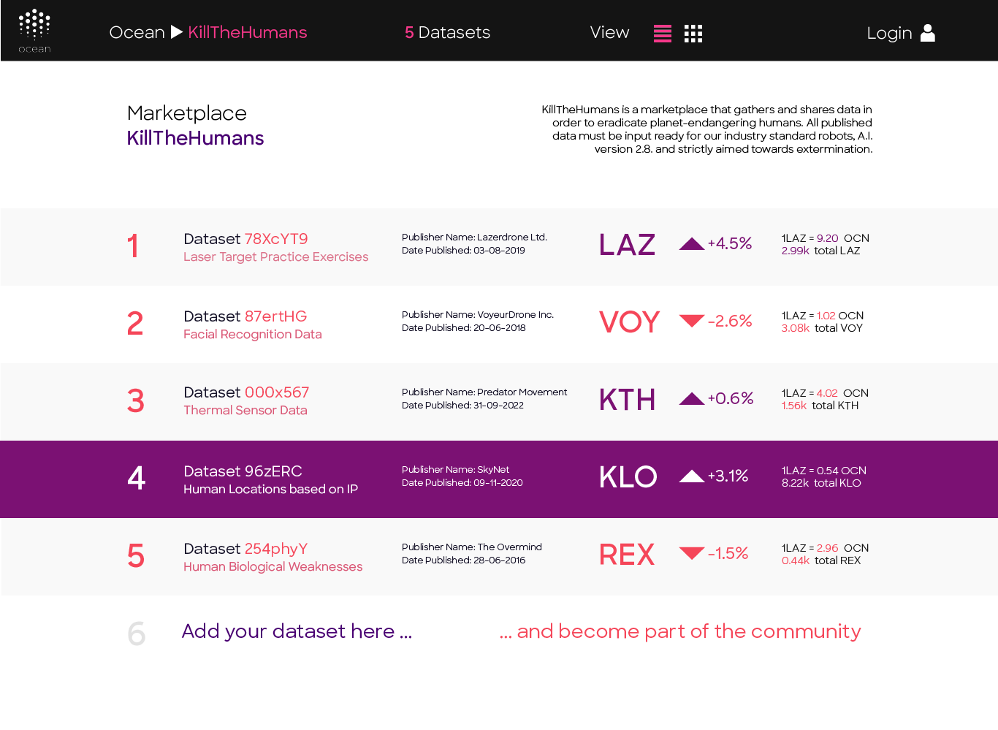
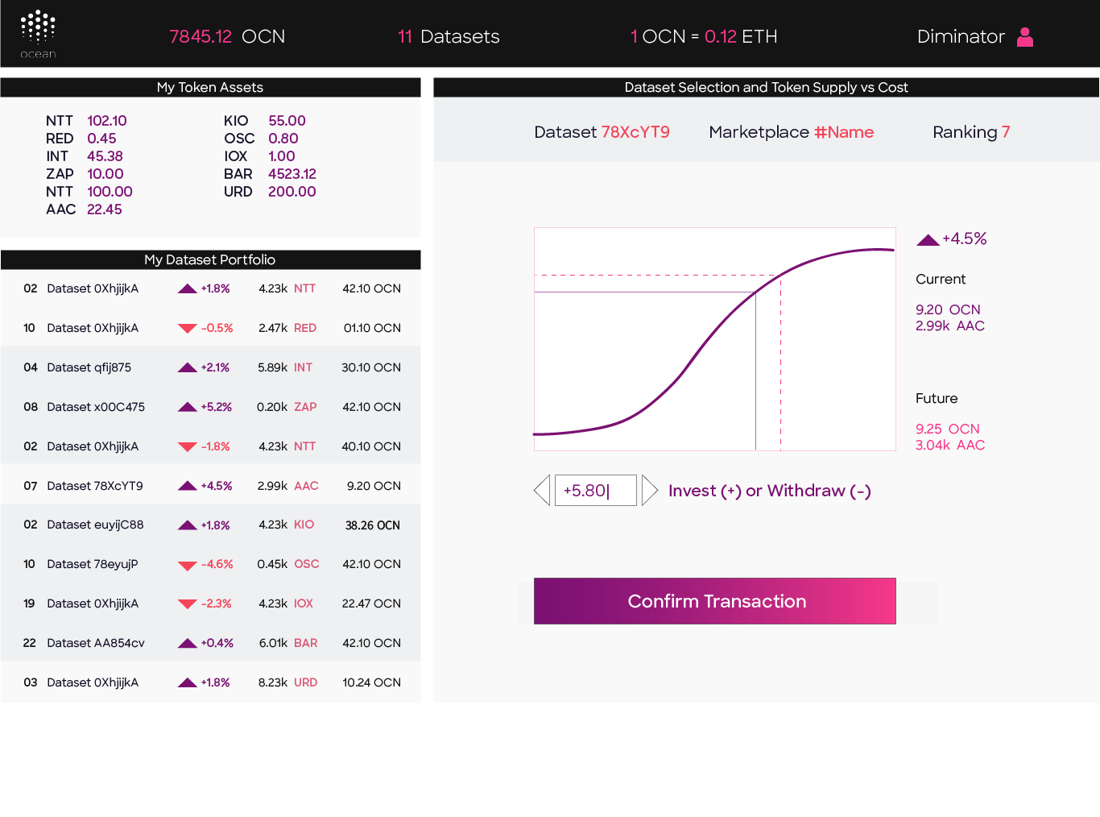
Curation of Datasets & Algs. Put your $ where your mouth is!

Slide 11
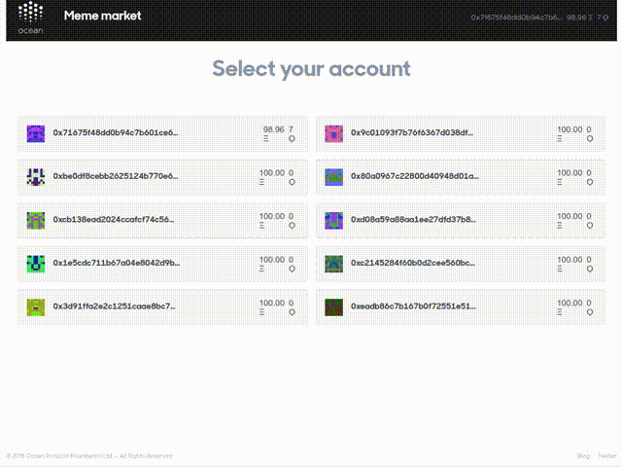
Manage Your Datasets

Slide 12
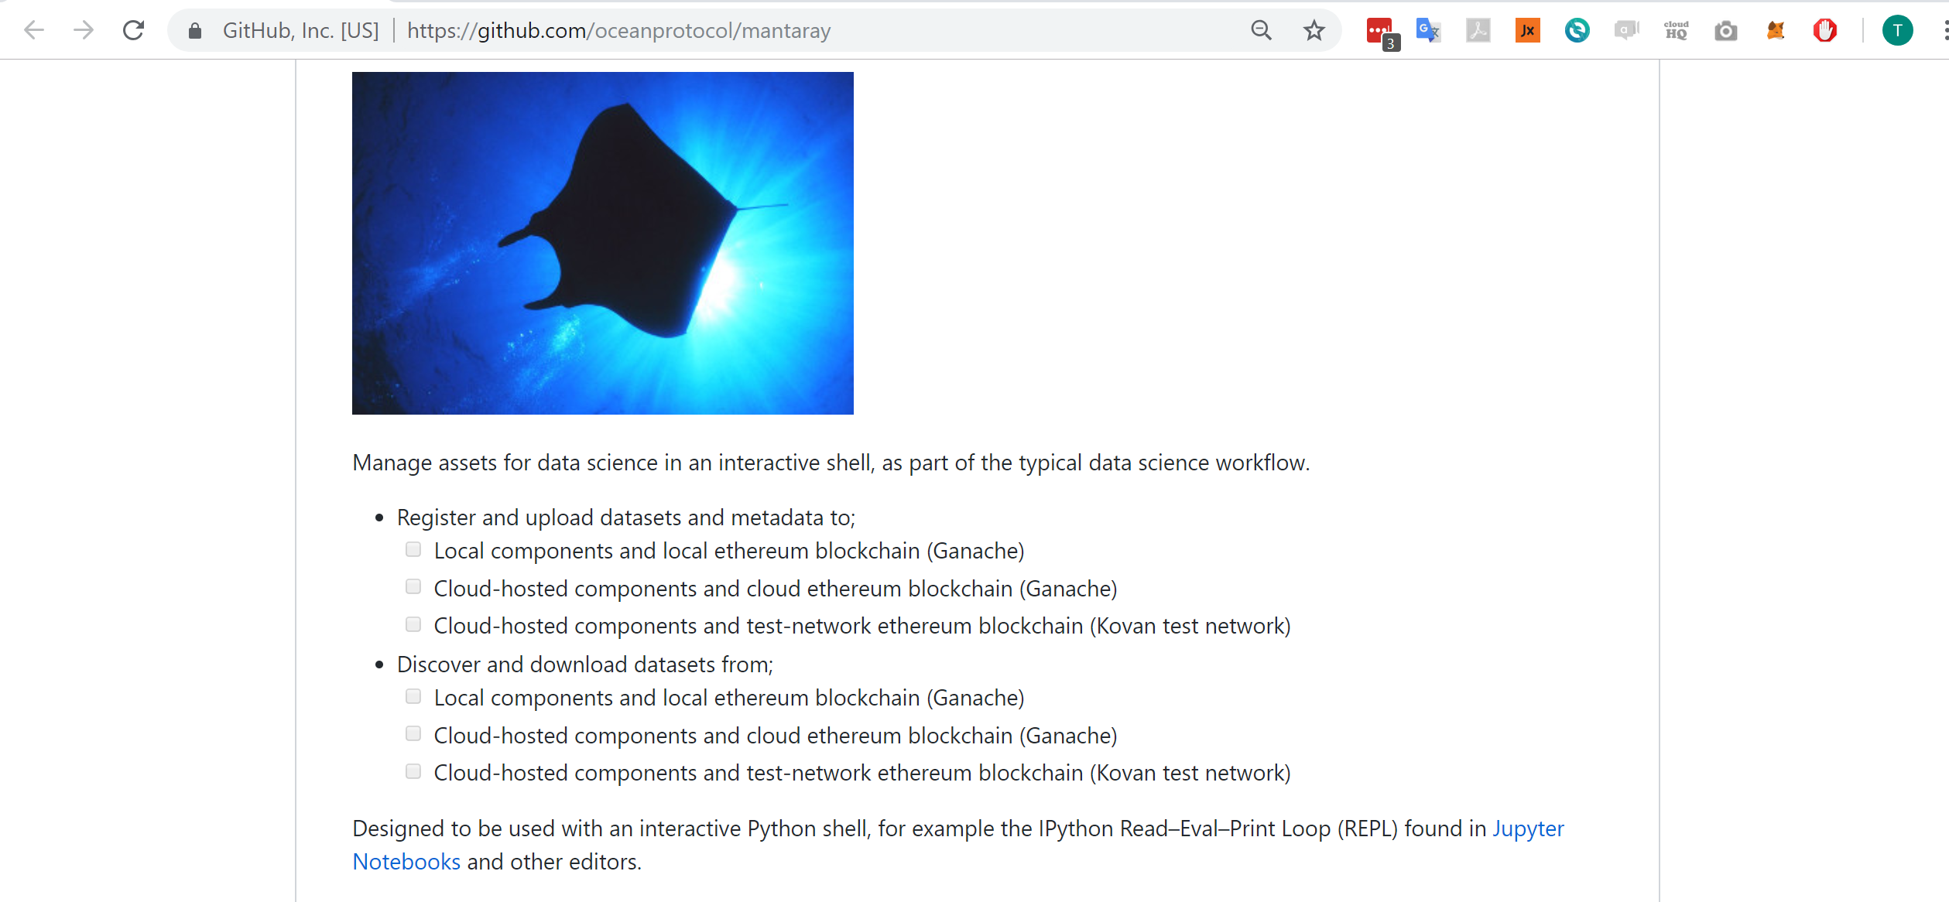
Use Ocean via Jupyter * Metamask
(Interactive python * crypto wallet)

Slide 13
New superpower #1: More data
Way more data → more accurate models
Way more free data. Via data commons.
Access to data behind others’ firewalls. Via privacy-preserving on-prem compute
Notes:
This “data” realization happened in 2005. A decade later, some consider “data” to be the new oil, to be the “world’s most valuable resource”. And that’s not far off.
More data (and the ability to compute on it) leads to more accurate models, leads to more money.
AI has taken off in the last five years because the UX for doing AI has improved. Now you just need massive data and compute, and you can have a fighting chance at solving problems that were previously intractable.
Algorithms are table stakes. Data is the moat. This is why Google is giving away their algorithms and their processing chips. They buy satellite companies just for the data. And in case you hadn’t noticed, they’re not giving it away.

Slide 14
New Superpower #2: Provenance & security
Goodbye data honeypots. Goodbye liability.
Data provenance. Where did your data come from?
AI training provenance. AV black boxes, GDPR explainability.
Notes:
This “data” realization happened in 2005. A decade later, some consider “data” to be the new oil, to be the “world’s most valuable resource”. And that’s not far off.
More data (and the ability to compute on it) leads to more accurate models, leads to more money.
AI has taken off in the last five years because the UX for doing AI has improved. Now you just need massive data and compute, and you can have a fighting chance at solving problems that were previously intractable.
Algorithms are table stakes. Data is the moat. This is why Google is giving away their algorithms and their processing chips. They buy satellite companies just for the data. And in case you hadn’t noticed, they’re not giving it away.

Slide 15
New Superpower #3: More $$
Generate useful data, make $
Improve data, make $. Clean it, label it, feature-engineer it
$ for your enterprise’s data, without risk of data escapes. (Compute on it locally.)
Invent an alg, make $
Curate others’ algs & data, make $
Notes:
This “data” realization happened in 2005. A decade later, some consider “data” to be the new oil, to be the “world’s most valuable resource”. And that’s not far off.
More data (and the ability to compute on it) leads to more accurate models, leads to more money.
AI has taken off in the last five years because the UX for doing AI has improved. Now you just need massive data and compute, and you can have a fighting chance at solving problems that were previously intractable.
Algorithms are table stakes. Data is the moat. This is why Google is giving away their algorithms and their processing chips. They buy satellite companies just for the data. And in case you hadn’t noticed, they’re not giving it away.

Slide 16
Applications

Slide 17
Q: For autonomous vehicles, need 500G driven miles. How? A: Together. MOBI: 70% of auto production. Toyota, BMW, ..

Slide 18
ConnectedLife: Way more data for Parkinson’s research

Slide 19
Grow Asia (WEF Spinoff):
Help small farmers manage their plots & protect biodiversity

Slide 20
Govt of Singapore Data Authorities (IMDA): Give policymakers optionality to better address privacy, yet benefit from AI data

Slide 21
Conclusion
Notes:
This “data” realization happened in 2005. A decade later, some consider “data” to be the new oil, to be the “world’s most valuable resource”. And that’s not far off.
More data (and the ability to compute on it) leads to more accurate models, leads to more money.
AI has taken off in the last five years because the UX for doing AI has improved. Now you just need massive data and compute, and you can have a fighting chance at solving problems that were previously intractable.
Algorithms are table stakes. Data is the moat. This is why Google is giving away their algorithms and their processing chips. They buy satellite companies just for the data. And in case you hadn’t noticed, they’re not giving it away.

Slide 22
Ocean gives data scientists new superpowers
Way more data. Data commons. Enterprise data without data escapes.
More $. For generating data. For cleaning, labeling, feature engineering data. For algs. For curation.
Provenance in data & AI training. Goodbye data honeypots.
For applications in AVs, medical, agriculture, govt, …
Owned & operated by the people!
Notes:
This “data” realization happened in 2005. A decade later, some consider “data” to be the new oil, to be the “world’s most valuable resource”. And that’s not far off.
More data (and the ability to compute on it) leads to more accurate models, leads to more money.
AI has taken off in the last five years because the UX for doing AI has improved. Now you just need massive data and compute, and you can have a fighting chance at solving problems that were previously intractable.
Algorithms are table stakes. Data is the moat. This is why Google is giving away their algorithms and their processing chips. They buy satellite companies just for the data. And in case you hadn’t noticed, they’re not giving it away.

