Slide 1
#ScalingAIforGood
With AI Commons
And Ocean Protocol
Trent McConaghy
Ocean Protocol
@trentmc0
Notes:
We want to create a bazaar - with various offerings, everyone can buy and sell, there is a lot of community and incentives.
It’s a fun place to be

Slide 2
What are we aiming for?
Realize the full potential of AI for Good

Slide 3
Challenges

Slide 4
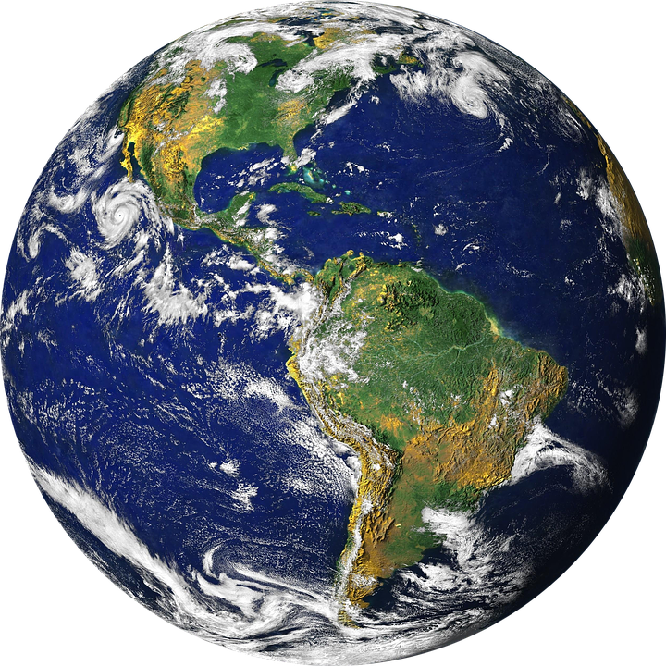
GAP
Problem owners
Problem solvers

Slide 5
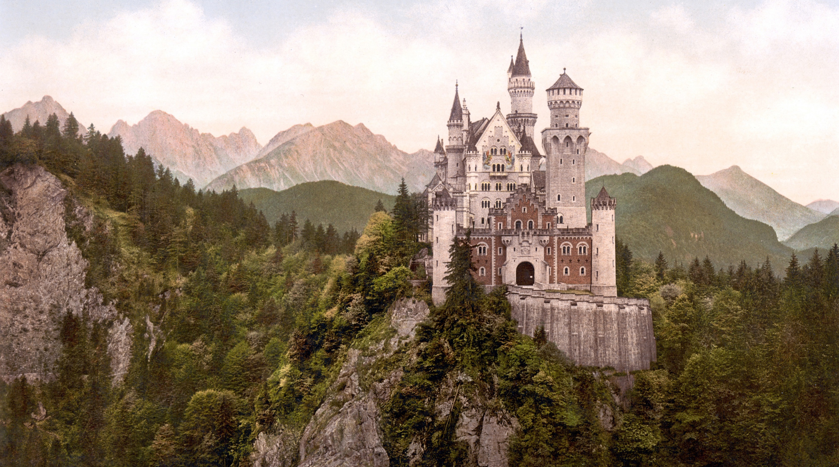
Challenge: silos

Slide 6
Towards
Scaling AI for Good

Slide 7
How to Scale AI for Good?
Community (first and foremost)
Connect problem owners & solvers
Scaling Funnel

Slide 8
AI Commons Community dedicated to #ScalingAIforGood

Slide 9
Problem owners
GAP
Problem solvers

Slide 10
Problem owners
Problem solvers
And the rest!
(MANY)
Data owners

Slide 11
Problem owners
Problem solvers
Funding
Data owners
#ScalingAIforGood Community
Policymakers
Social Entrepreneurs
Public utility networks, cloud

Slide 12
Scaling Funnel : Engagement at each stage
Problem specified
Problem owners
AI prototype
Data owners
Policy Makers
#ScalingAIforGood Community
Funding
Public utility networks, cloud
0 → 1
in the field
Problem solvers
1 → N
in the field
Social Entrepreneurs
Notes:
You heard about some of the AI in Action examples
These examples were only coming from an initial pool of 150 competitors.
But how do you scale AI for Good to thousands of teams
and address many more problems?

Slide 13
Data owners
Storage & compute
Problem owners
Problem solvers
Service provider frontends
For data commons,
Storage & compute markets
AI Commons Frontend
Specify Problems
Data science tools
Data, storage, compute
Network rewards
Jupyter notebooks
Notebooks, data, storage, compute
Public utility network incentivizing data:
Block rewards for data
Privacy-preserving AI modeling
Notes:
This “data” realization happened in 2005. A decade later, some consider “data” to be the new oil, to be the “world’s most valuable resource”. And that’s not far off.
More data (and the ability to compute on it) leads to more accurate models, leads to more money.
AI has taken off in the last five years because the UX for doing AI has improved. Now you just need massive data and compute, and you can have a fighting chance at solving problems that were previously intractable.
Algorithms are table stakes. Data is the moat. This is why Google is giving away their algorithms and their processing chips. They buy satellite companies just for the data. And in case you hadn’t noticed, they’re not giving it away.

Slide 14
To unlock AI for good
We need to unlock data
Notes:
We want to create a bazaar - with various offerings, everyone can buy and sell, there is a lot of community and incentives.
It’s a fun place to be

Slide 15
How to unlock data?
Connect data-haves with data have-nots
Incentivize for commons data
Unlock private data
Notes:
We want to create a bazaar - with various offerings, everyone can buy and sell, there is a lot of community and incentives.
It’s a fun place to be

Slide 16
How to unlock data?
Connect data-haves with data have-nots
Incentivize for commons data
Unlock private data
Notes:
We want to create a bazaar - with various offerings, everyone can buy and sell, there is a lot of community and incentives.
It’s a fun place to be

Slide 17
1. Connect data-haves with data have-nots: easy to create data marketplaces / commons
Have data
Have AI
(Want data)
Have data
Have data
Have AI
(Want data)
Have AI
(Want data)
Have data
Have AI
(Want data)
Have AI
(Want data)
Have data
Data marketplace
DM
DM
DM
DM
DM
DM
DM
DM
DM
DM
DM
DM
DM
DM
DM
DM
DM
DM
DM
Substrate for AI Commons
Notes:
This “data” realization happened in 2005. A decade later, some consider “data” to be the new oil, to be the “world’s most valuable resource”. And that’s not far off.
More data (and the ability to compute on it) leads to more accurate models, leads to more money.
AI has taken off in the last five years because the UX for doing AI has improved. Now you just need massive data and compute, and you can have a fighting chance at solving problems that were previously intractable.
Algorithms are table stakes. Data is the moat. This is why Google is giving away their algorithms and their processing chips. They buy satellite companies just for the data. And in case you hadn’t noticed, they’re not giving it away.

Slide 18
How to unlock data?
Connect data-haves with data have-nots
Incentivize for commons data
Unlock private data
Notes:
We want to create a bazaar - with various offerings, everyone can buy and sell, there is a lot of community and incentives.
It’s a fun place to be

Slide 19
How to unlock data?
Connect data-haves with data have-nots
Incentivize for commons data
Unlock private data
Notes:
We want to create a bazaar - with various offerings, everyone can buy and sell, there is a lot of community and incentives.
It’s a fun place to be

Slide 20
The most valuable data
Is private data

Slide 21
Data you have
(Private)
Data you want
1000 hospitals
1 hospital

Slide 22
Showstopper:
Privacy Concerns
Data you have
Data you want
1000 hospitals
1 hospital

Slide 23
More Data is Good and Bad
Accuracy ↑ ↑ ↑
Lives Saved ↑ ↑ ↑
Less Data
More Data
Privacy ↓ ↓ ↓
Exploits ↑ ↑ ↑

Slide 24
Unlock the value of the data while preserving privacy
How: Bring compute to the data
modeling algorithm
model predictions
f(x)
Substrate for
decentralized orchestration
private data
privately train model
private model
Data stays behind firewall
Notes:
This “data” realization happened in 2005. A decade later, some consider “data” to be the new oil, to be the “world’s most valuable resource”. And that’s not far off.
More data (and the ability to compute on it) leads to more accurate models, leads to more money.
AI has taken off in the last five years because the UX for doing AI has improved. Now you just need massive data and compute, and you can have a fighting chance at solving problems that were previously intractable.
Algorithms are table stakes. Data is the moat. This is why Google is giving away their algorithms and their processing chips. They buy satellite companies just for the data. And in case you hadn’t noticed, they’re not giving it away.

Slide 25
Ocean Resolves the Tradeoff by Bringing Compute to the Data
Accuracy ↑ ↑ ↑
Lives Saved↑ ↑ ↑
Data -
Data ↑ ↑ ↑
Privacy ↓ ↓ ↓
Exploits ↑ ↑ ↑
Retain privacy:)

Slide 26
Applications

Slide 27
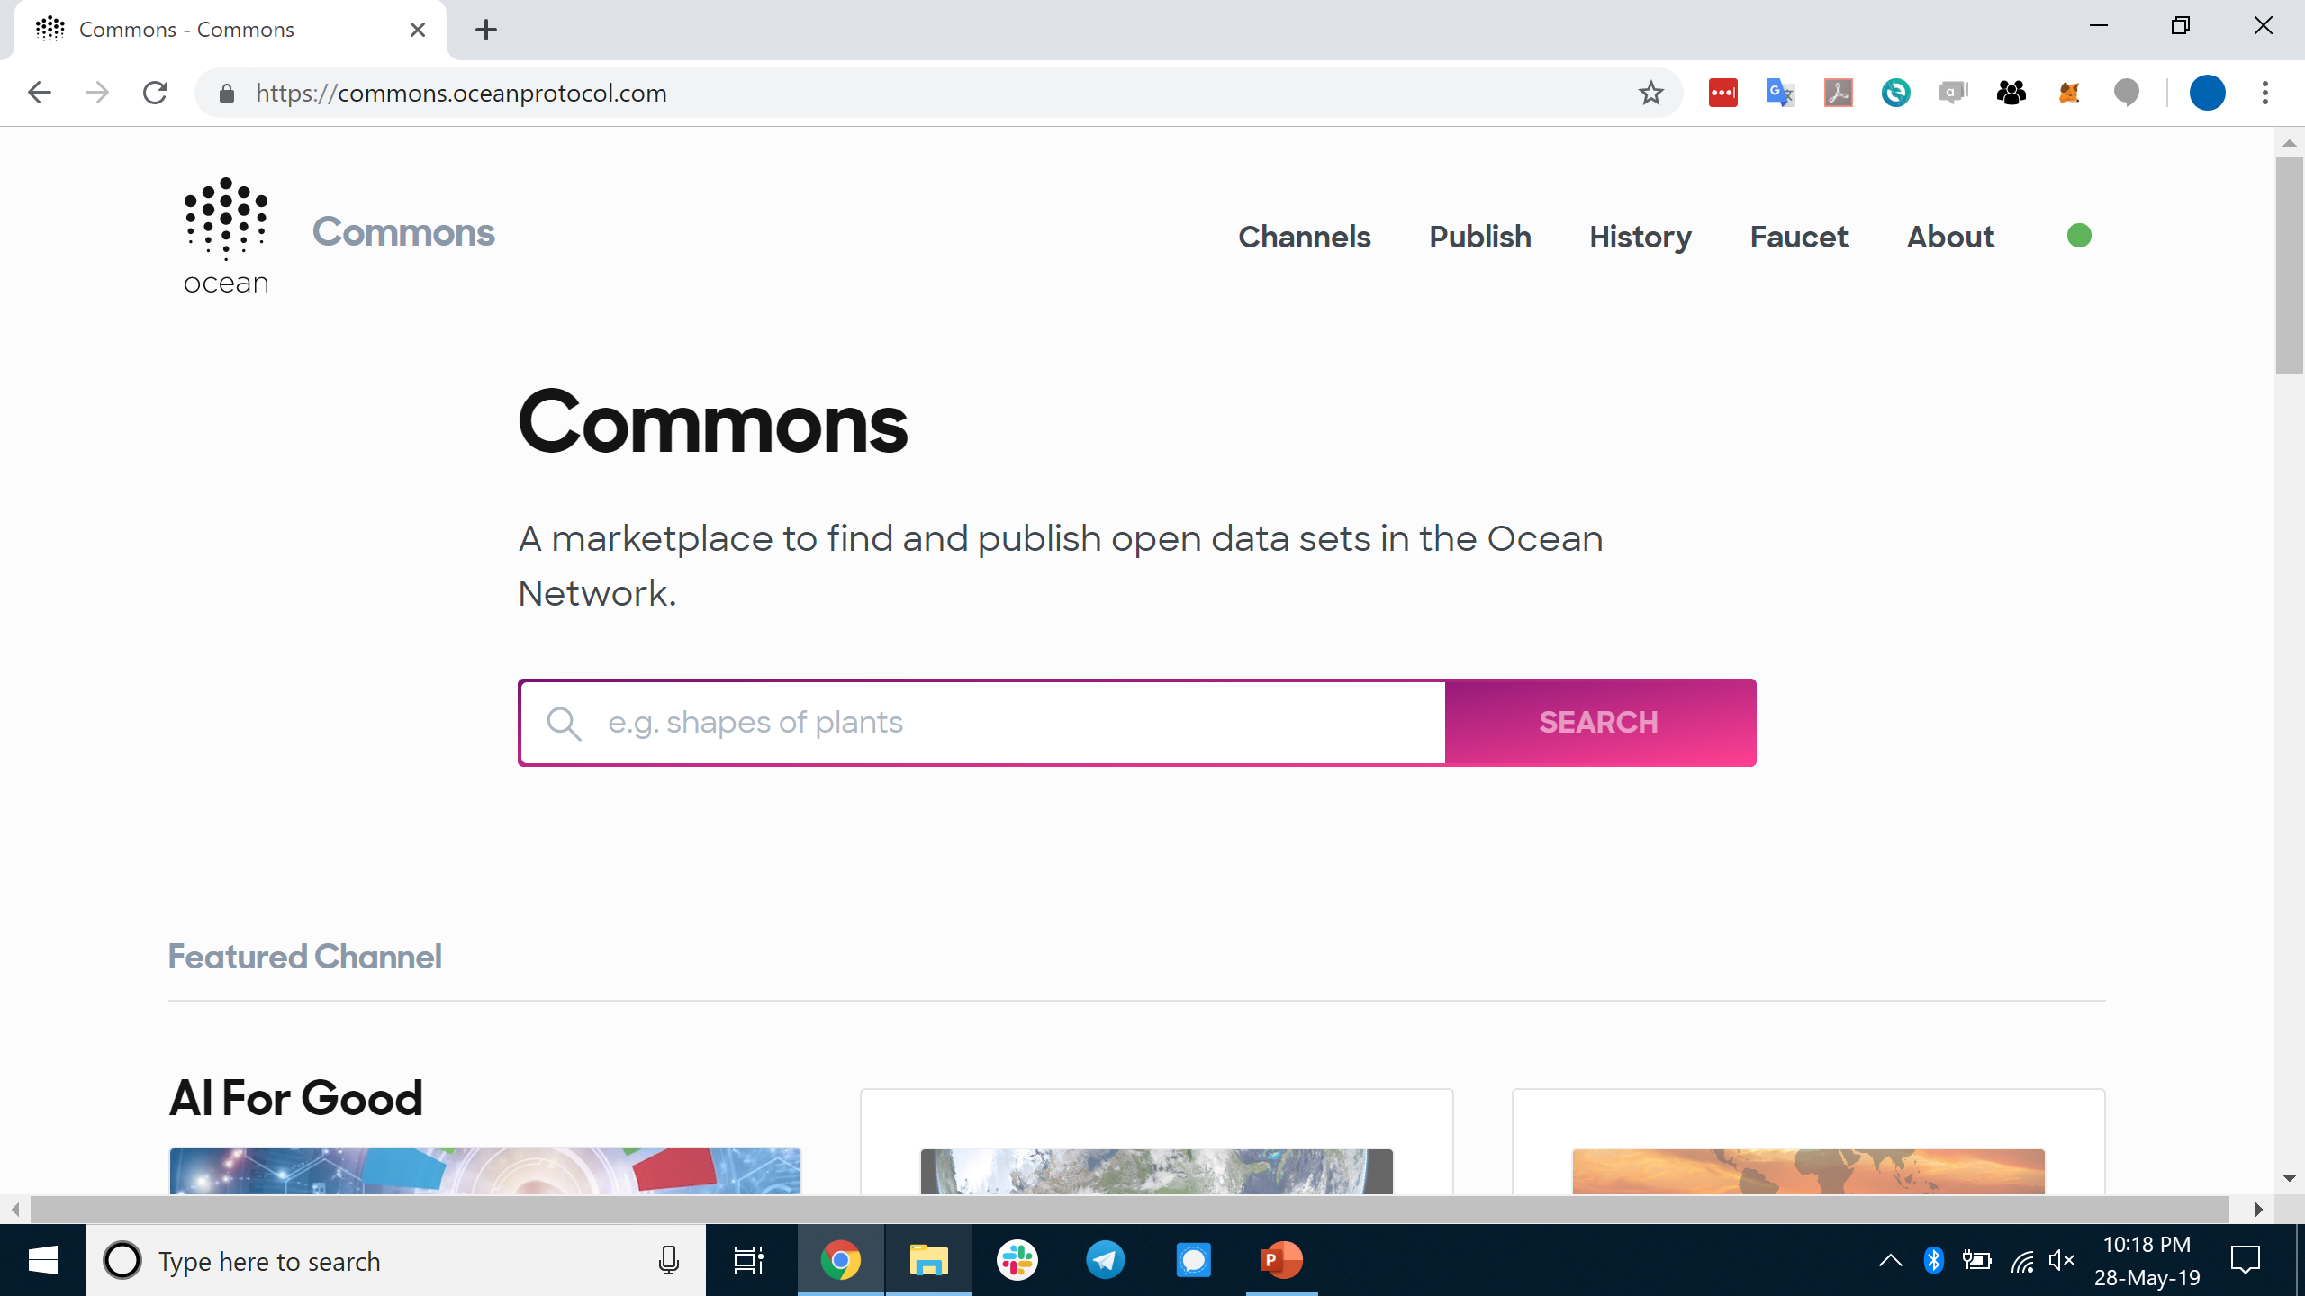
For AI Commons, a Public AI Data Interface commons.oceanprotocol.com

Slide 28
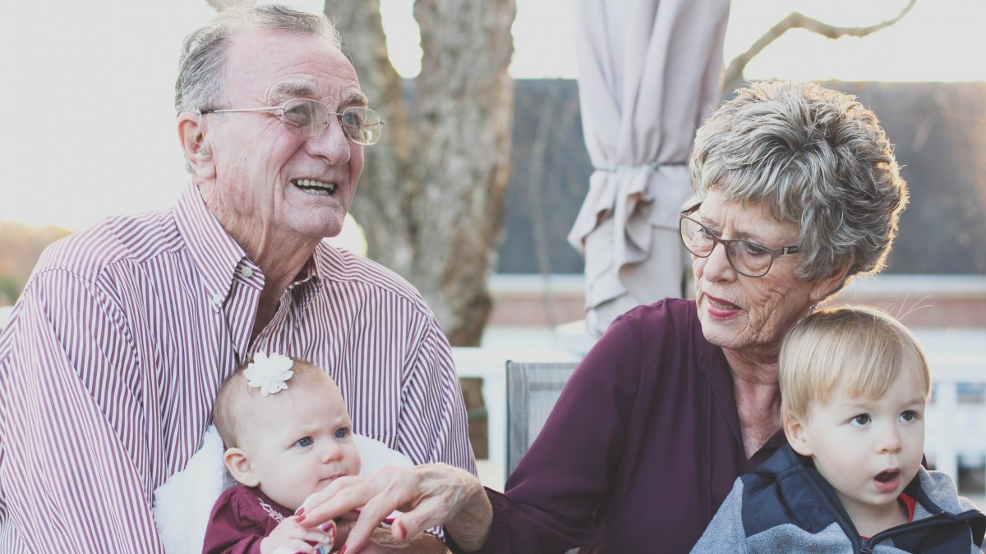
Better predict Parkinson’s by connecting data across hospitals & borders; promoting & promoting research collaboration (ConnectedLife)

Slide 29
Govt of Singapore Data Authorities (IMDA): Sandboxes for enterprises, SMEs, and government agencies

Slide 30
Some Collaborators
Notes:
This “data” realization happened in 2005. A decade later, some consider “data” to be the new oil, to be the “world’s most valuable resource”. And that’s not far off.
More data (and the ability to compute on it) leads to more accurate models, leads to more money.
AI has taken off in the last five years because the UX for doing AI has improved. Now you just need massive data and compute, and you can have a fighting chance at solving problems that were previously intractable.
Algorithms are table stakes. Data is the moat. This is why Google is giving away their algorithms and their processing chips. They buy satellite companies just for the data. And in case you hadn’t noticed, they’re not giving it away.

Slide 31
On Ocean Protocol
Is:
A protocol (standard): specifications of how machines communicate
And, a community (8K stakeholders, 250 ambassadors, 30 advisors)
And, a network that implements the protocol
And, a nonprofit foundation to steward the protocol & catalyze community
Characteristics of protocol / network:
Decentralized – no single entity controls
Global
Open
Reconciles privacy
Can plug in legals
Incentives for sharing commons data
Reconciles commons & entrepreneurial opportunities
Notes:
This “data” realization happened in 2005. A decade later, some consider “data” to be the new oil, to be the “world’s most valuable resource”. And that’s not far off.
More data (and the ability to compute on it) leads to more accurate models, leads to more money.
AI has taken off in the last five years because the UX for doing AI has improved. Now you just need massive data and compute, and you can have a fighting chance at solving problems that were previously intractable.
Algorithms are table stakes. Data is the moat. This is why Google is giving away their algorithms and their processing chips. They buy satellite companies just for the data. And in case you hadn’t noticed, they’re not giving it away.

Slide 32
Conclusion

Slide 33
What are we aiming for?
Realize the full potential of AI for Good

Slide 34
What if
50 Projects
x
100 Nations
in
5 years
?

Slide 35
Scaling Funnel : The Big Picture, End-to-End
Problem specified
Problem owners
AI prototype
Data owners
Policy Makers
#ScalingAIforGood Community
Funding
Public utility networks, cloud
0 → 1
in the field
Problem solvers
1 → N
in the field
Social Entrepreneurs
Notes:
You heard about some of the AI in Action examples
These examples were only coming from an initial pool of 150 competitors.
But how do you scale AI for Good to thousands of teams
and address many more problems?

Slide 36
Data owners
Storage & compute
Problem owners
Problem solvers
Service provider frontends
For data commons,
Storage & compute markets
AI Commons Frontend
Specify Problems
Data science tools
Ocean Protocol: a substrate for AI Commons
Notes:
This “data” realization happened in 2005. A decade later, some consider “data” to be the new oil, to be the “world’s most valuable resource”. And that’s not far off.
More data (and the ability to compute on it) leads to more accurate models, leads to more money.
AI has taken off in the last five years because the UX for doing AI has improved. Now you just need massive data and compute, and you can have a fighting chance at solving problems that were previously intractable.
Algorithms are table stakes. Data is the moat. This is why Google is giving away their algorithms and their processing chips. They buy satellite companies just for the data. And in case you hadn’t noticed, they’re not giving it away.

